Slide 1
Kross
Create folder css and img in project folder

Slide 2
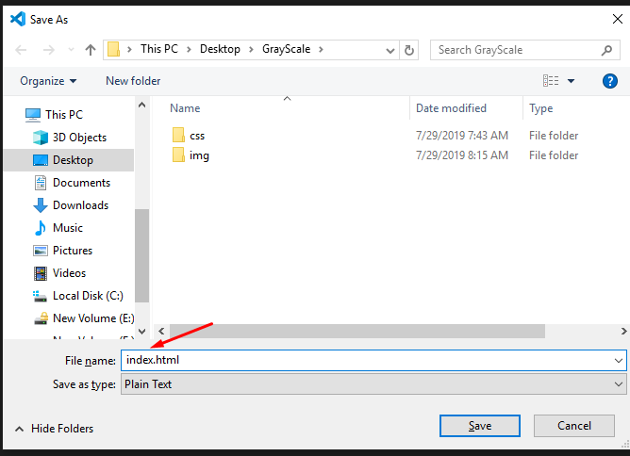
Create index.html in main folder

Slide 3
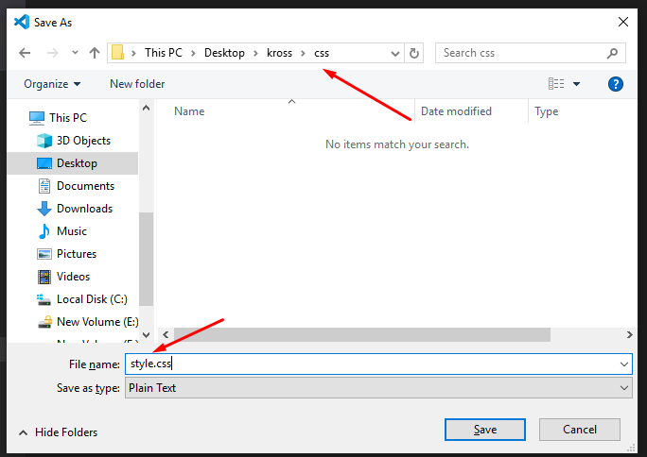
Create style.css in css folder

Slide 4
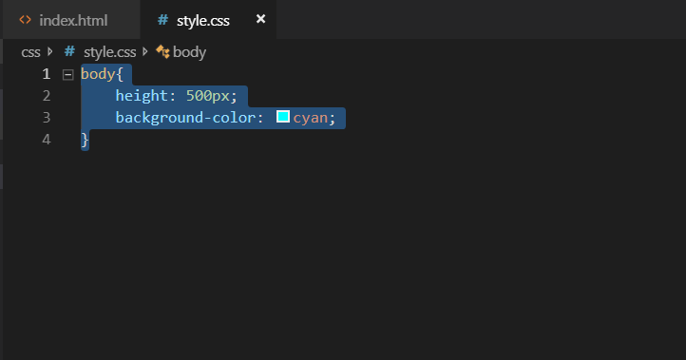
Add css in style.css for cheek

Slide 5
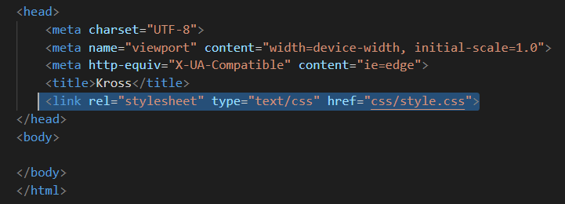
Link external style in index.html

Slide 6

Output

Slide 7
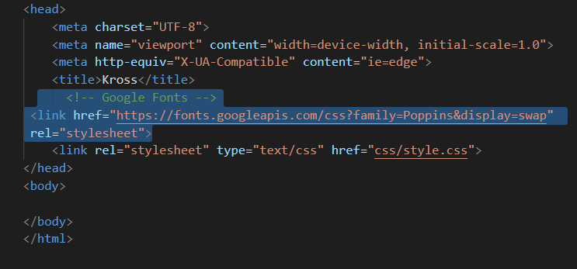
Add google font

Slide 8
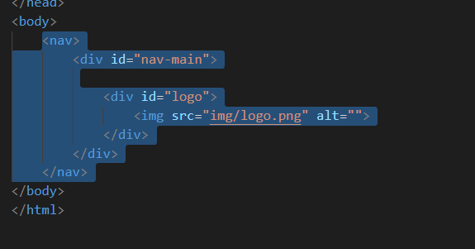
Add nav in index.html

Slide 9

Output

Slide 10
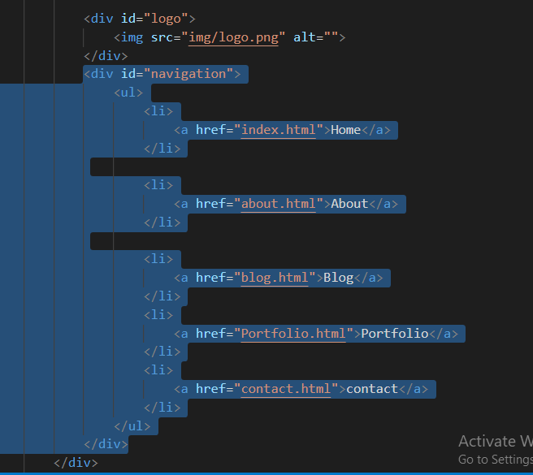
Add novigation after log div

Slide 11

Output

Slide 12
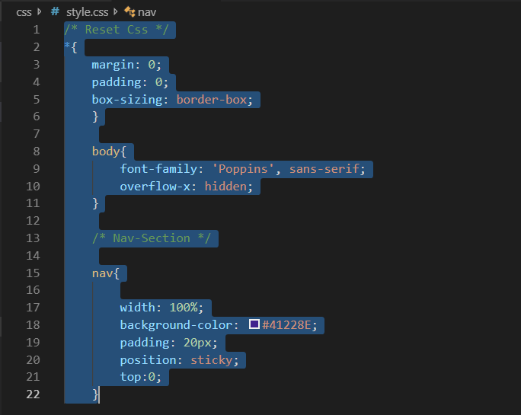
Add css I style.css

Slide 13
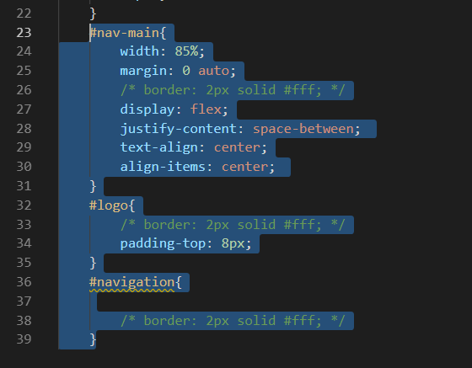
Add css I style.css

Slide 14
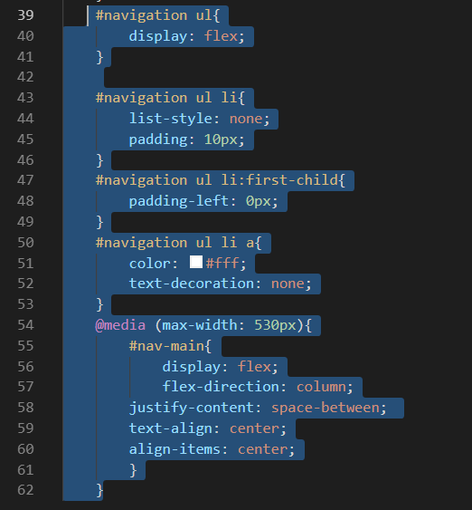
Add css I style.css

Slide 15
Output

Slide 16
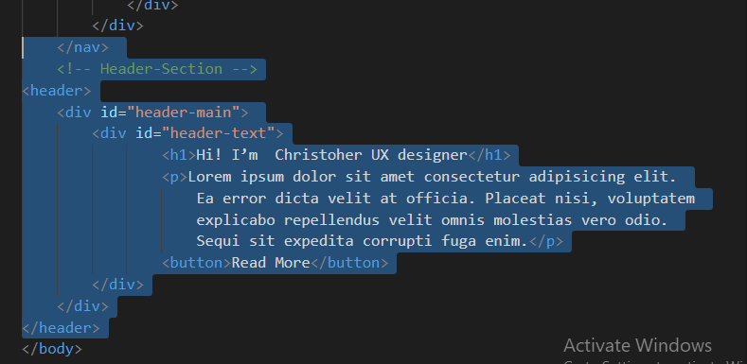
Add header in index.html

Slide 17
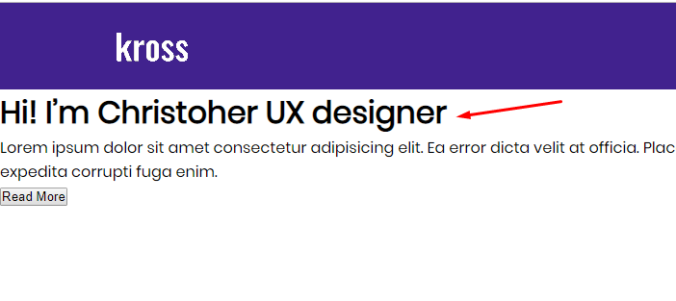
Output

Slide 18
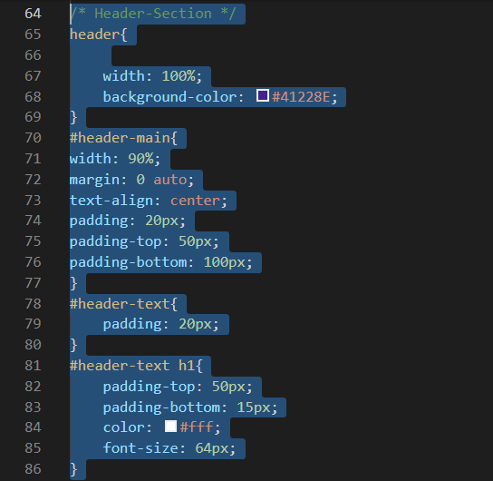
Add css in style.css for header

Slide 19
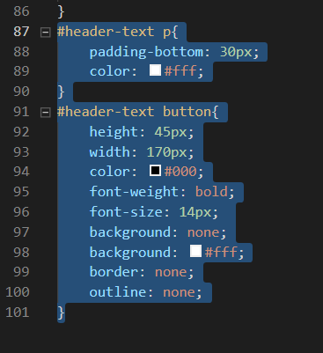
Add css in style.css for header

Slide 20
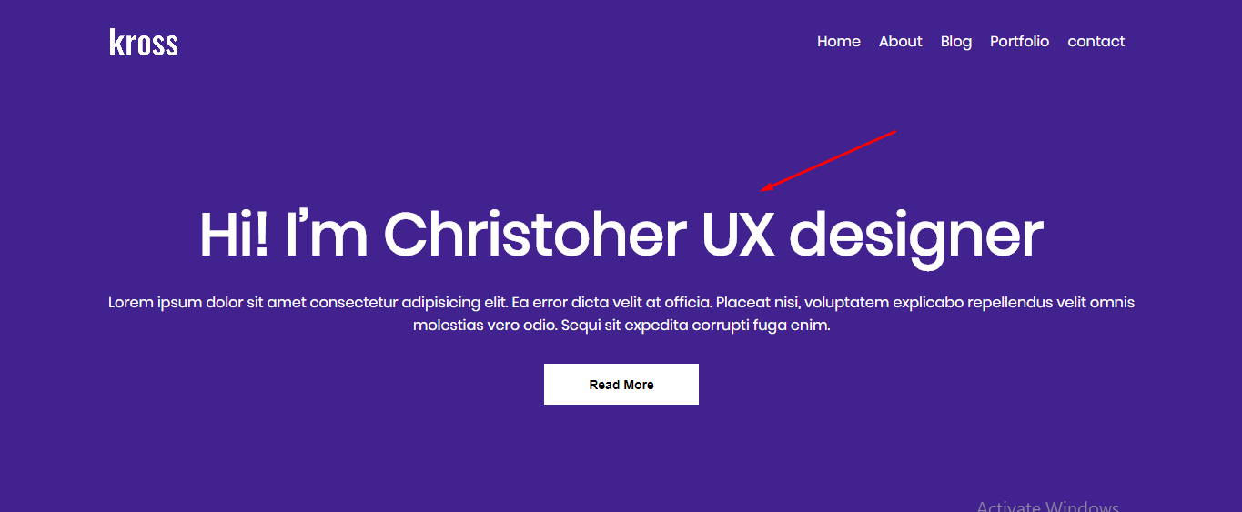
Output

Slide 21
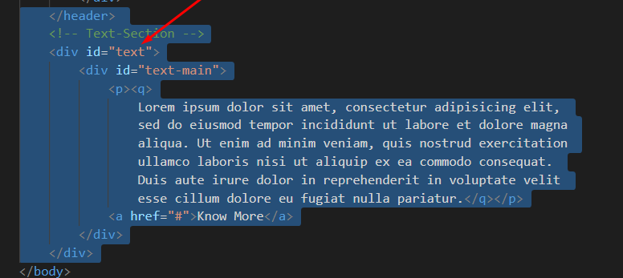
Add markup in index.html

Slide 22
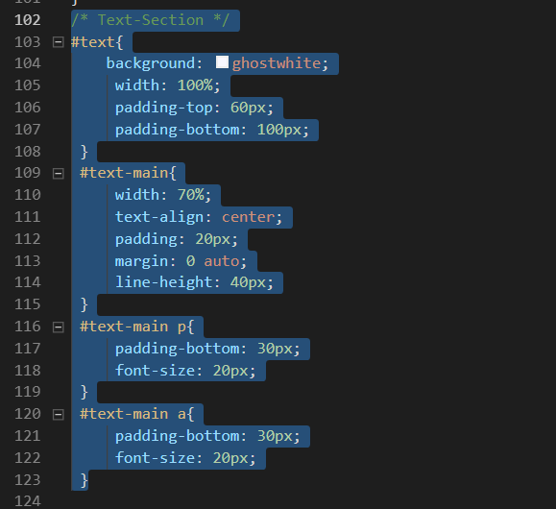
Add css in style.css

Slide 23
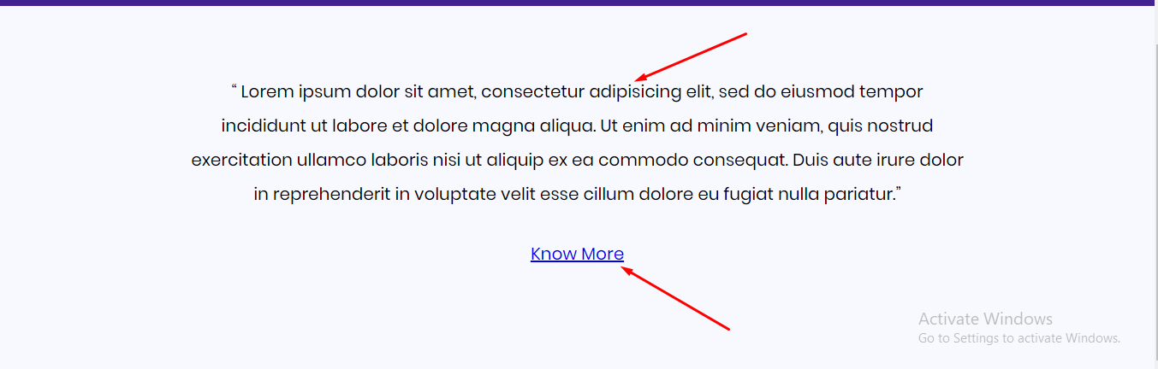
Output

Slide 24
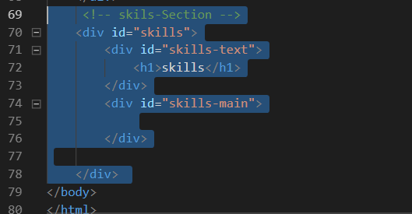
Add markup in index.html

Slide 25
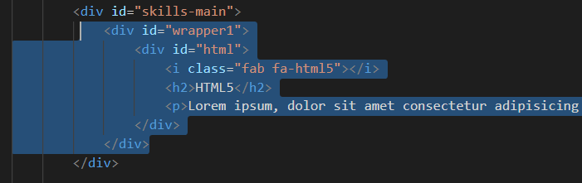
Add markup in index.html

Slide 26
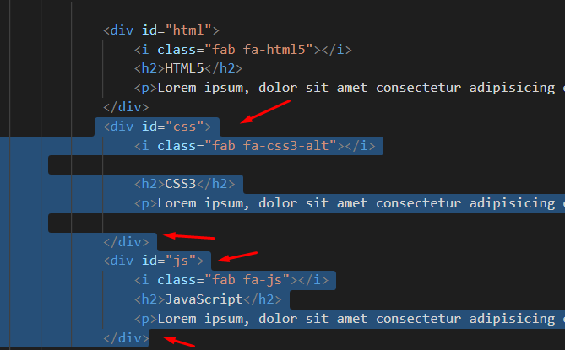
Add markup in index.html

Slide 27
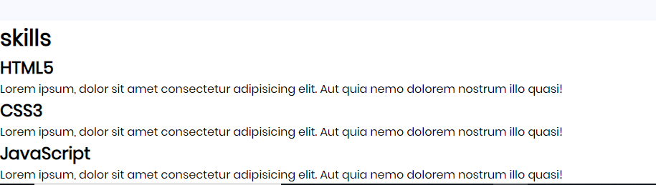
Output

Slide 28
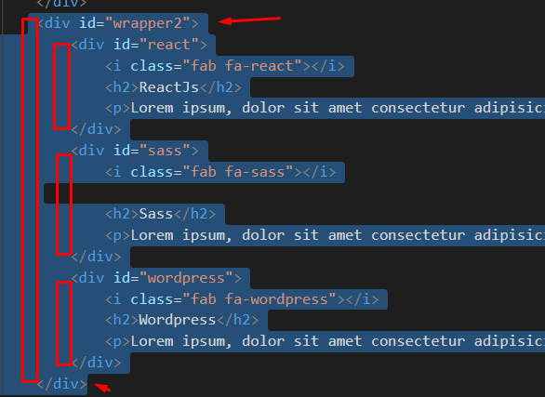
Add more markup in index.html

Slide 29
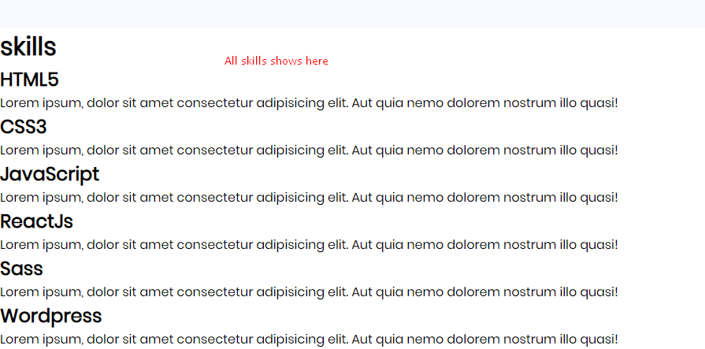
Output

Slide 30
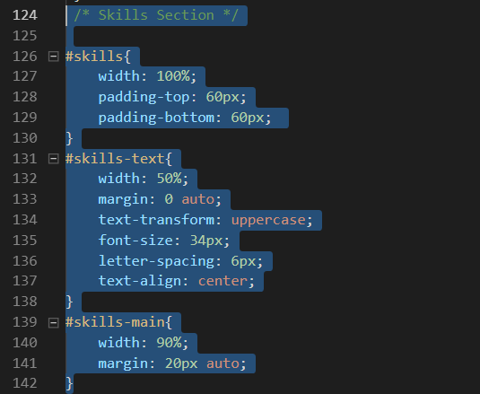
Add css style.css

Slide 31
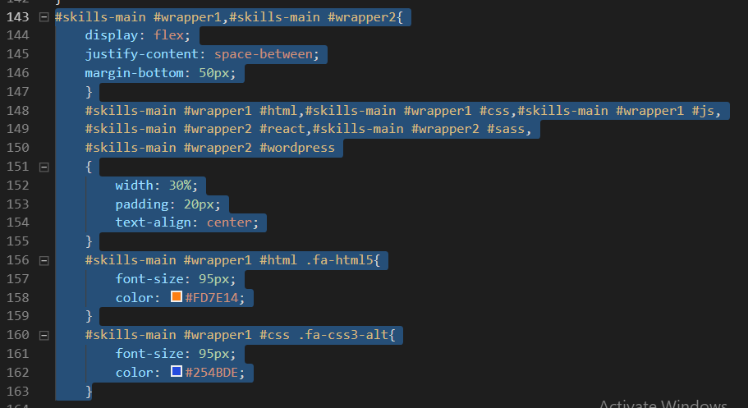
Add more css style.css

Slide 32
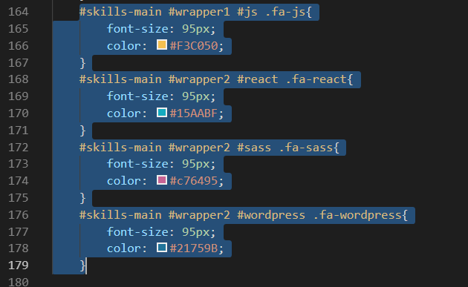
Add more css style.css

Slide 33
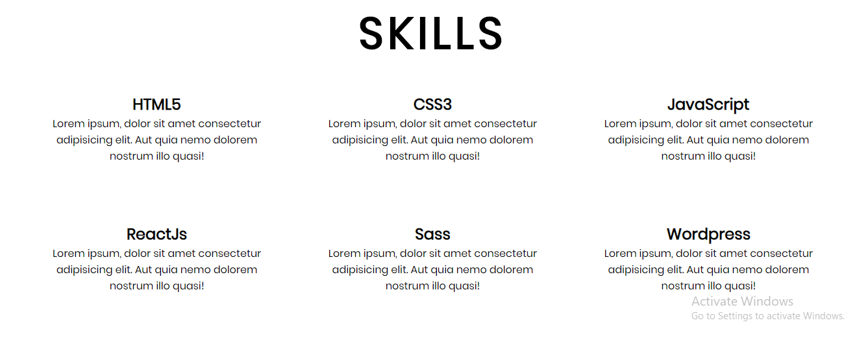
Output

Slide 34
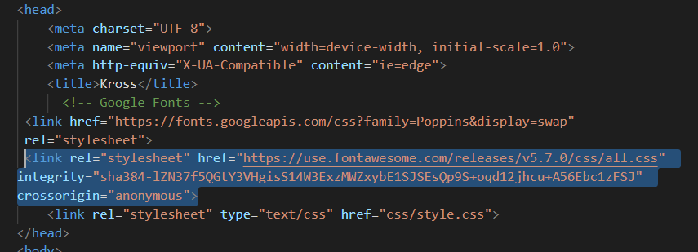
Add font awesome in head

Slide 35
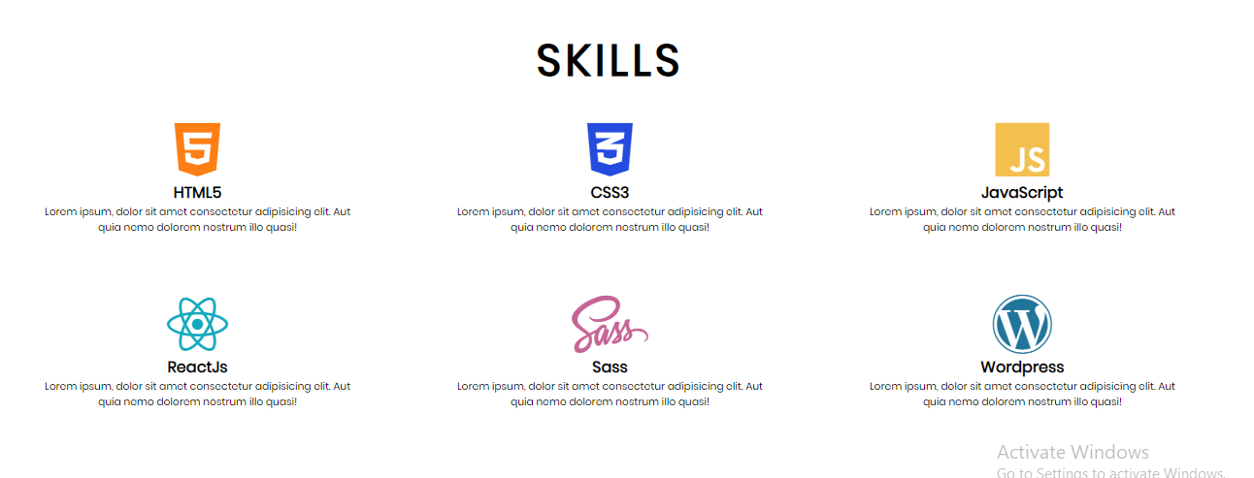
Output

Slide 36
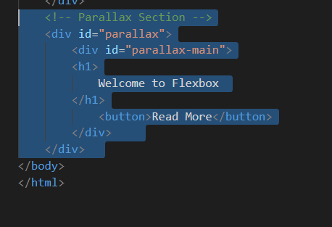
Add text in index.html

Slide 37
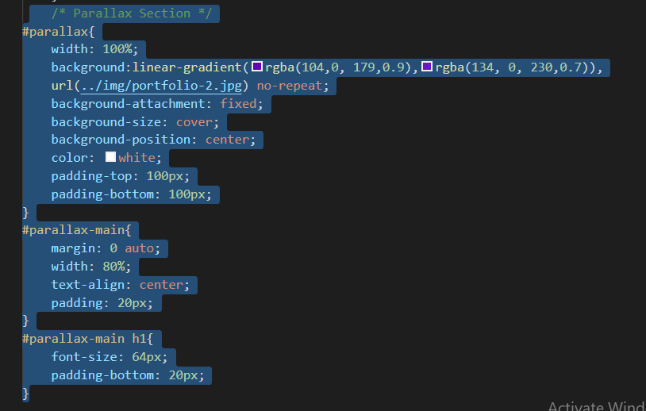
Add css in style.css

Slide 38
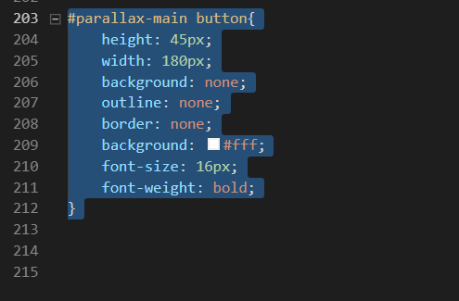
Add more css in style.css

Slide 39

Output

Slide 40
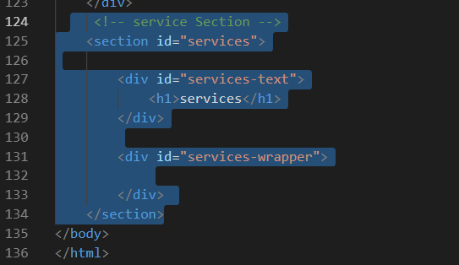
Add service section in index.html

Slide 41
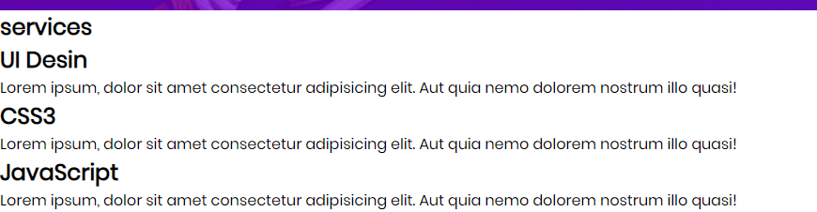
Add more markp in index.html

Slide 42
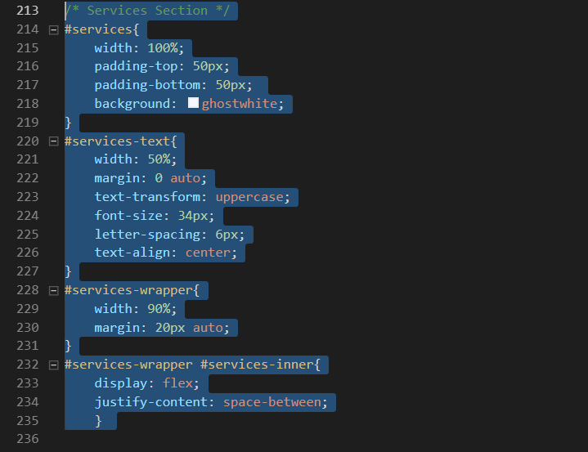
Add css in style.css

Slide 43
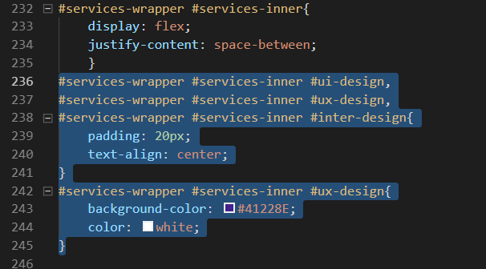
Add more css in style.css

Slide 44
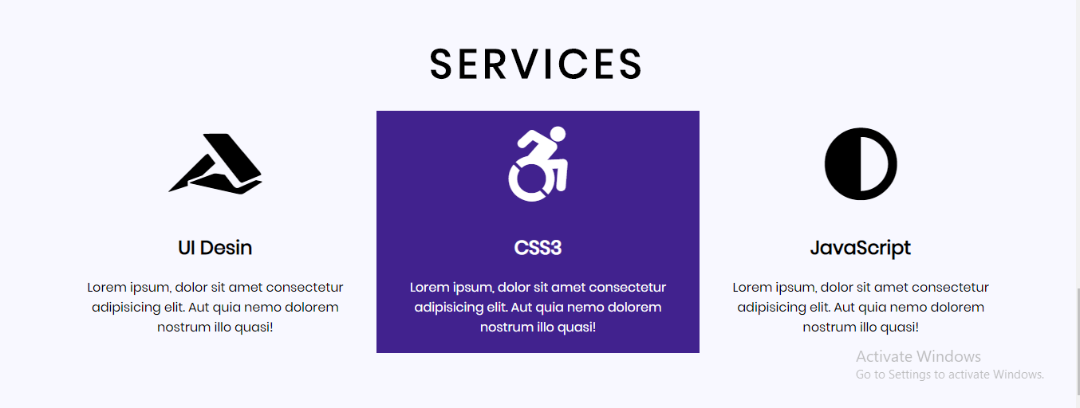
Output

Slide 45
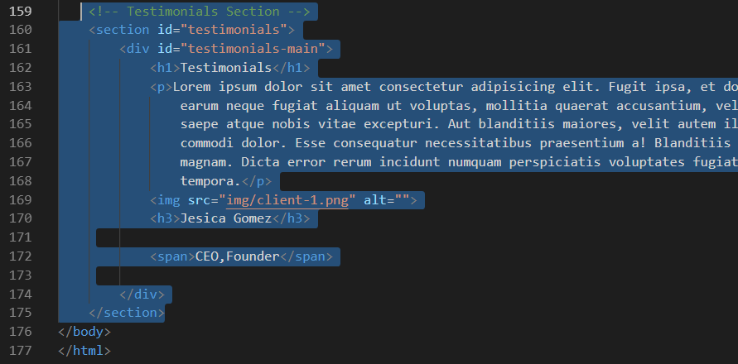
Add markup in index.html

Slide 46
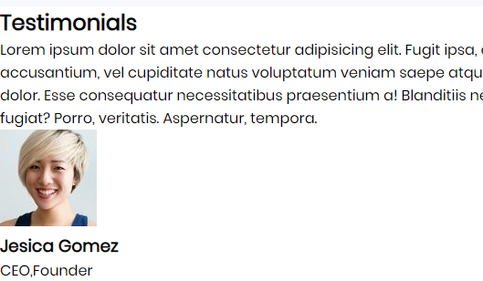
Output

Slide 47
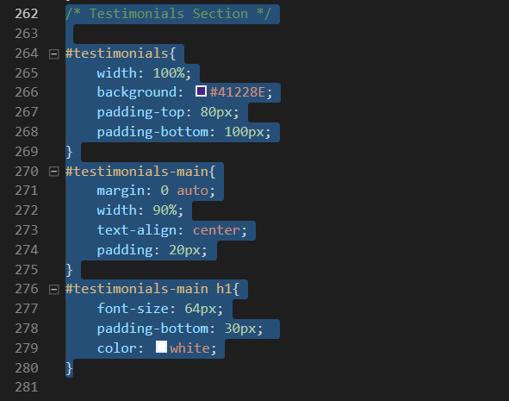
Add style in style.css

Slide 48
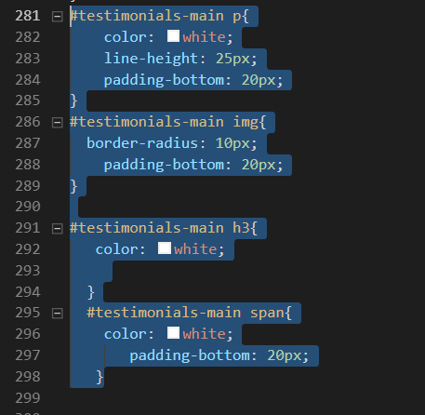
Add more style in style.css

Slide 49
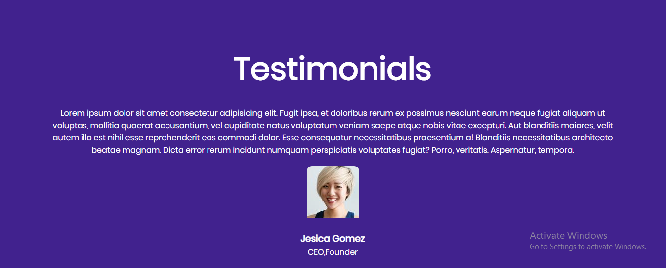
Output

Slide 50
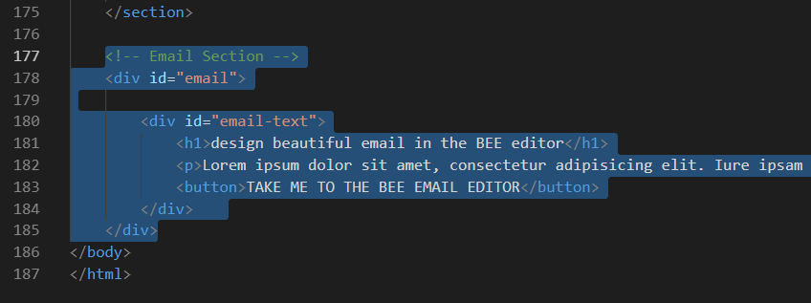
Add markup in index.html

Slide 51
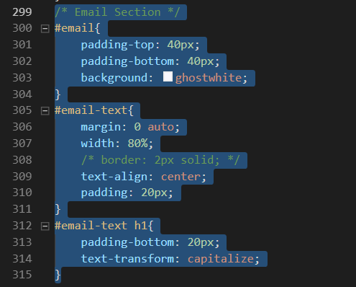
Add css in style.css

Slide 52
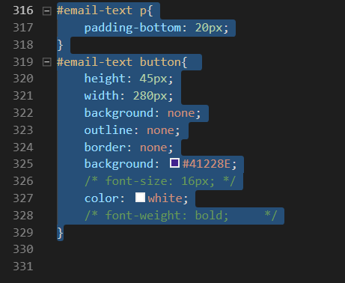
Add more css in style.css

Slide 53
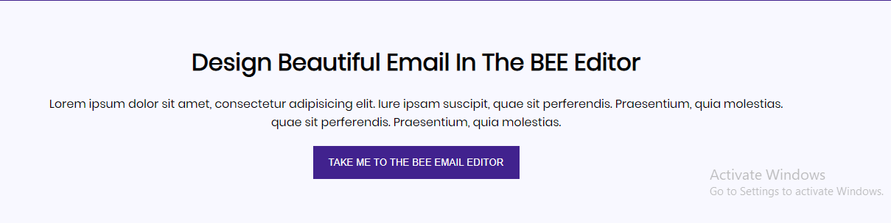
Output

Slide 54
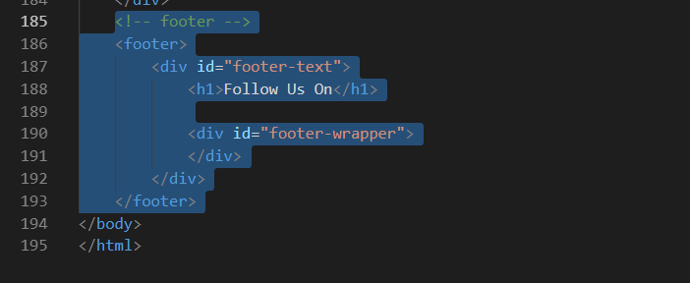
Add markup in index.html

Slide 55
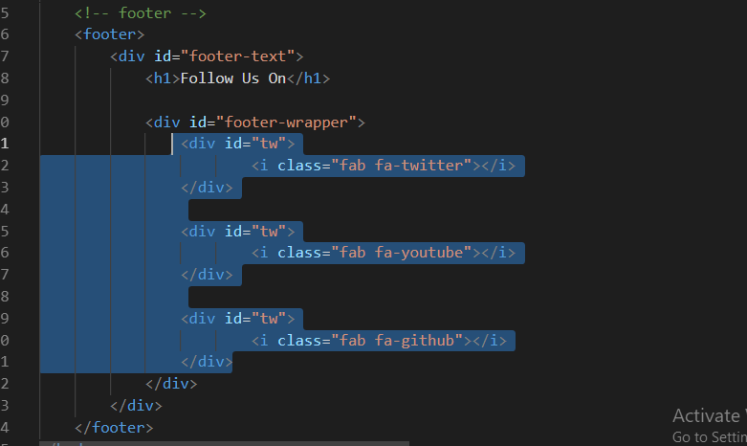
Add more markup in index.html

Slide 56
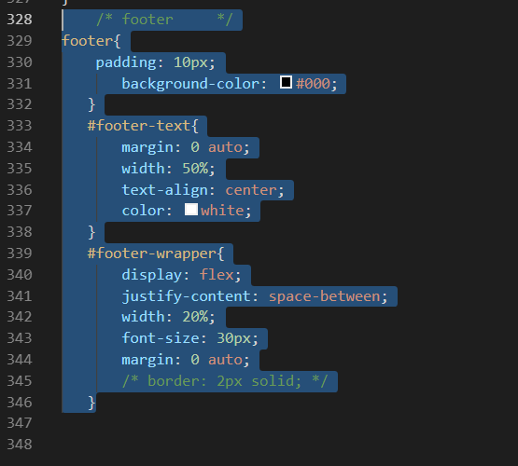
Add css style.css i

Slide 57

Output

Slide 58

Create about.html page in project

Slide 59

Copy nave,header, service,email and footer from index.html

Slide 60

Continue… paste services section

Slide 61

Continue… email and footer section

Slide 62

Make a file about.css in css folder

Slide 63

Add css in sbout.css copy all nav section

Slide 64

Link about.css file in about.html

Slide 65

Add css in about.css

Slide 66

Output

Slide 67

Add markup in about.html

Slide 68

Add css in sbout.css

Slide 69

Add more css in sbout.css

Slide 70

Output

Slide 71

Add markup in about.html

Slide 72

Add more markup in about.html

Slide 73

Add css in about.css

Slide 74

Add more css in about.css

Slide 75

Add more css in about.css

Slide 76

Output

Slide 77

Add markup in about.html

Slide 78

Add more markup in about.html

Slide 79

Output

Slide 80

Add css in about.css

Slide 81

Add css in about.css

Slide 82

Output

Slide 83

Copy email and footer section css from style.css

Slide 84


Slide 85

Create contect.html main folder

Slide 86

Copy nav,header,email,footer in contact.html

Slide 87

Create contact.css in css folder

Slide 88

Copt their css from about.css nav,header,email and in

Slide 89

Change header text in contact.html

Slide 90

Link contact.css in index.html

Slide 91

Output

Slide 92

Add markup in contact.html

Slide 93

Add more markup in contact.html

Slide 94

Output

Slide 95

Add css in contcat.css

Slide 96

Add more css in contcat.css

Slide 97

Add more css in contcat.css

Slide 98

Output

Slide 99


